Slide 1
CRYPTOGRAPHY

Slide 2
Secure Communication
Well established needs for secure communication
  War time communication
  Business transactions

Slide 3
SECURE COMMUNICATION
Requirements of secure communication
  Secrecy
    Only intended receiver understands the message
  Authentication
    Sender and receiver need to confirm each others identity
  Message Integrity
    Ensure that their communication has not been altered, either maliciously or by accident during transmission

Slide 4
CRYPTOGRAPHY
Practice and study of hiding information/using encryption to conceal text
Secret writing is the strongest tool for controlling against many kind of security threats. Well-disguised data cannot be read, modified, or fabricated easily.

Slide 5
CRYPTOGRAPHY
The art of secret writing.
The art of mangling information into apparent unintelligibility
in a manner allowing a secret method of unmangling.

Slide 6
TERMINOLOGY
Cryptographer- Attempt to translate coded material back to its original form.
Cryptanalysis – Attempt to find some weakness or insecurity in a cryptographic scheme so that the coded material translated back to its original form.
A cryptographer works on behalf of a legitimate sender or receiver, whereas a cryptanalyst works on behalf of an unauthorized interceptor.

Slide 7
TERMINOLOGY…
Cryptology - research into and study of encryption and decryption; it includes both cryptography and cryptanalysis.
Key – a value used in the encryption process to encrypt and decrypt/ also called crypto-variable.

Slide 8
TERMINOLOGY…
The original form of message is known as plaintext.
Cipher text – this is the scrambled message produced as output. It depends on the plaintext and the secret key. Or the encrypted form is called cipher text.
  The formal notation used to describe the transformations between plaintext and cipher text. C=E(K, P) and P=D(K, C) where C represents the cipher text, E is the Encryption rule, P is the plaintext, K is the crypto variable and D is the description rule.

Slide 9
TERMINOLOGY…
Encryption is the process of encoding a message so that its meaning is not obvious; decryption is the reverse process, transforming an encrypted message back into its normal, original form.
Alternatively the terms encode and decode or encipher and decipher are used instead of encrypt and decrypt.

Slide 10
TERMINOLOGY…
There are slight difference in the meaning of these pairs of words.
Encoding is the process of translating entire words or phrase to other words or phrases.
Whereas enciphering is translating letters or symbols individually.
Encryption covers both encoding and enciphering.

Slide 11
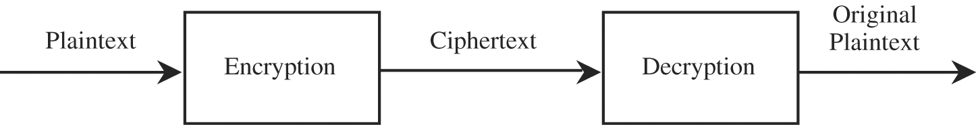
TERMINOLOGY…

Slide 12
CRYPTOGRAPHIC SYSTEM
Cryptographic systems are characterized along three independent dimensions:
The type of operations used for transforming plaintext to cipher-text. All encryption algorithms are based on two general principles:
substitution, in which each element in the plaintext (bit, letter, group of bits or letters) is mapped into another element, and
transposition, in which elements in the plaintext are rearranged. The fundamental requirement is that no information be lost (that is, that all operations are reversible). Most systems, referred to as product systems, involve multiple stages of substitutions and transpositions.

Slide 13
CRYPTOGRAPHIC SYSTEM
The number of keys used. If both sender and receiver use the same key, the system is referred to as symmetric, single-key, secret-key, or conventional encryption. If the sender and receiver use different keys, the system is referred to as asymmetric, two-key, or public-key encryption.
The way in which the plaintext is processed. A block cipher processes the input one block of elements at a time, producing an output block for each input block. A stream cipher processes the input elements continuously, producing output one element at a time, as it goes along.

Slide 14
CRYPTANALYSIS
A cryptanalysis’s chore is to break an encryption. That is, the cryptanalysis attempts to deduce the original meaning of a particular of a ciphertext message. He hopes to determine which encryption algorithm matches the encryption so that other messages encoded in the same way can be broken.

Slide 15
SYMMETRIC ENCRYPTION
Uses one key for both encryption and decryption
Receiver and sender share same key (private key) to lock and unlock
Also called private key encryption
Must securely distribute keys to other parties

Slide 16
SYMMETRIC ENCRYPTION…
Anyone with key can either encrypt or decrypt (similar to password)
Very fast to encrypt or decrypt
Provides authentication as long as key remains secret

Slide 17
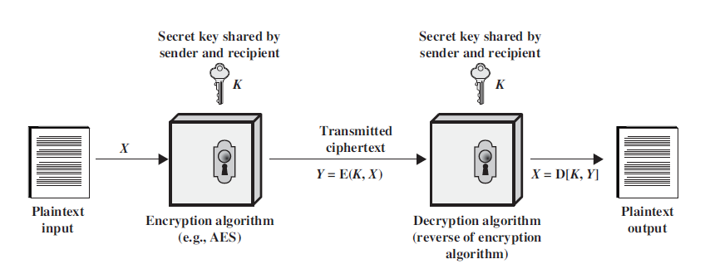
SYMMETRIC ENCRYPTION

Slide 18
SYMMETRIC ENCRYPTION MODEL
A symmetric encryption scheme has five ingredients
  Plaintext
  Encryption Algorithm
  Secret Key
  Cipher Text
  Decryption Algorithm

Slide 19
SYMMETRIC ENCRYPTION
There are two requirements for secure use of conventional encryption:
  The opponent should be unable to decrypt ciphertext or discover the key even if he or she is in possession of a number of ciphertexts together with the plaintext that produced each ciphertext
  Sender and receiver must have obtained copies of the secret key in a secure fashion and must keep the key secure. If someone can discover the key and knows the algorithm, all communication using this key is readable.

Slide 20
ASYMMETRIC ENCRYPTION
Receiver and sender have two keys – public and private
Public key can be sent in an e-mail message or posted in a public directory
Public key used to encrypt and private key to decrypt or vise-versa
Requires a lot of resources

Slide 21
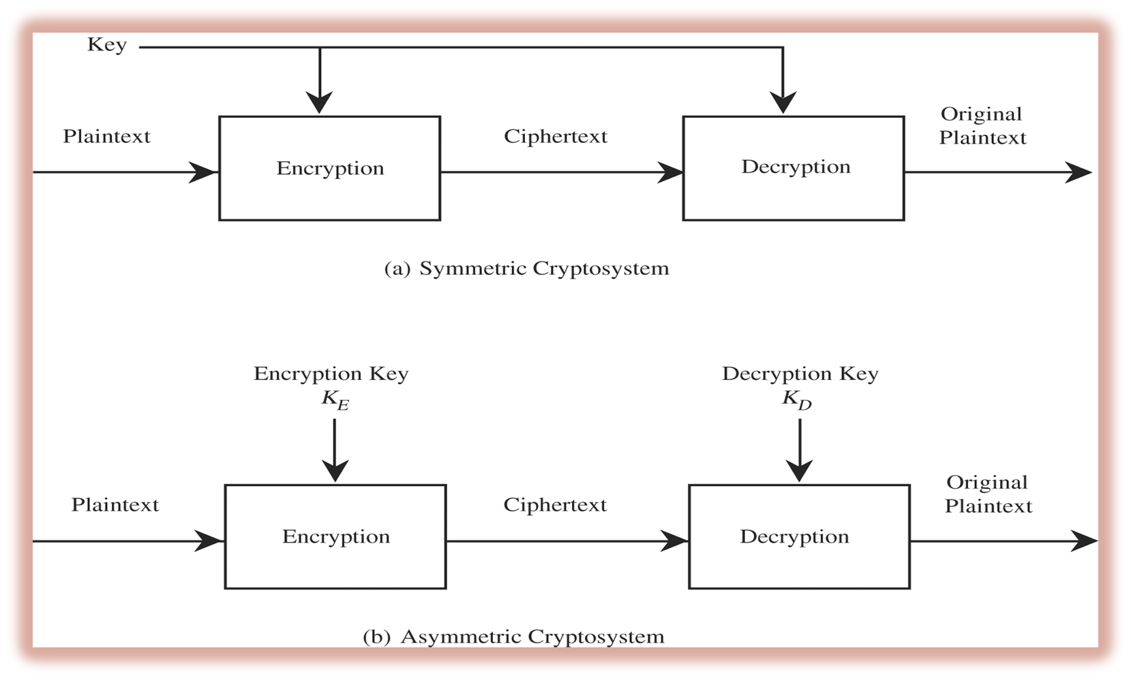

Slide 22
CRYPTANALYSIS…
A cryptanalyst can attempt to do any or all of following things:
Break a single message
Recognise patterns in encrypted messages to be able to break subsequent ones by applying straightforward decryption algorithm
Infer some meaning without even braking the encryption such as noticing an unusual frequency of communication or determining something by whether the communication was short or long
Deduce the key, to break subsequent messages easily
Find weaknesses in the implementation or environment of use of encryption
Find general weaknesses in an encryption algorithm, without necessarily having intercepted any messages.

Slide 23
BRUTE-FORCE ATTACK
The attacker tries every possible key on a piece of cipher text until an intelligible translation into plaintext is obtained. On average half of all possible keys must be tried to achieve success.

Slide 24
BREAKABLE ENCRYPTION
An encryption algorithm is called breakable, when given enough time and data an analyst can determine the algorithm.
However an algorithm that is theoretically breakable may in fact be impractical to try to break.
Consider a 25 character message that is expressed in just uppercase letters. A given cipher scheme may have 26²⁵ (approximately 10³⁵ )possible decipherments, so the task is to elect the right one out of the 26²⁵ . If computer performs on the order of 10¹⁰ operations per second, finding decipherment may require on the order of 10¹⁶ seconds or roughly 10¹¹ years.

Slide 25
An encryption scheme is unconditionally secure if the cipher text generated by the scheme, follow either of the following criteria
  The cost of breaking the cipher exceeds the value of the encrypted information.
  The time required to break the cipher exceeds the useful lifetime of the information.

Slide 26
SYMMETRIC ENCRYPTION
Two types
Substitution Technique : the letter of plaintext are replaced by other letters or symbols.
Example : Name → IUPX
Transposition Technique : performing some sort of permutation on the plaintext letters. A rearrangement of letters of the plain text.
Example : Name → MEAN

Slide 27
SUBSTITUTION CIPHER
A substitution technique is one in which the letters of plaintext are replaced by other letters or by numbers or symbols. If the plaintext is viewed as a sequence of bits, then substitution involves replacing plaintext bit patterns with ciphertext bit patterns.
Secret codes that use a correspondence table with which to substitute a character or symbol for each character of the original message.

Slide 28
SUBSTITUTION TECHNIQUE
Mono-alphabetic cipher
  Fixed substitution.
  A single cipher alphabet for each plain alphabet is used through out the process.
  Example: MY NAME ----> NZ OBNF
  Polyalphabetic cipher
    Cipher alphabet for each plain alphabet may be different at different positions through out the process.
    Example : MY NAME ----> NZ OBLF

Slide 29
THE CAESAR CIPHER
Julius Caesar is said to have been the first to use this scheme.
Also called SHIFT Cipher.
Mono alphabetic Cipher
Each letter is translated to the letter a fixed number of places after it in the alphabet
Ciphers simply shift characters in an alphabet
Caesar used a shift of 3
Advantages
  Easy to memorize and implement
Disadvantage
  Pattern is obvious

Slide 30
THE CAESAR CIPHER ALGORITHM
For each plaintext letter , substitute the ciphertext letter :
C = E(3, p) = (p + 3) mod 26
A shift may be of any amount, so that the general Caesar algorithm is
C = E(k, p) = (p + k) mod 26
where takes on a value in the range 1 to 25.The decryption algorithm is simply
p = D(k, C) = (C - k) mod 26

Slide 31
CRYPTANALYSIS OF CAESAR CIPHER
Three important characteristics of this problem enabled us to use a brute force cryptanalysis:
The encryption and decryption algorithms are known.
There are only 25 keys to try.
The language of the plaintext is known and easily recognizable.

Slide 32
PLAYFAIR CIPHER
Encrypts a pair of letters called Diagraph
Example if the plain text is FRIEND then break it into digraphs ( as FR IE ND) and encrypt it.
Based on a 5 x 5 matrix of letters constructed using a keyword (KEY).
Hard to break the code.
Polyalphabetic cipher
This cipher was actually invented by British scientist Sir Charles Wheatstone in 1854, but it bears the name of his friend Baron Playfair of St. Andrews, who championed the cipher at the British foreign office.
Notes:
It was used for tactical purposes by British forces in the Second Boer War and in World War I and for the same purpose by the Australians during World War II. This was because Playfair is reasonably fast to use and requires no special equipment. A typical scenario for Playfair use would be to protect important but non-critical secrets during actual combat. By the time the enemy cryptanalysts could break the message the information was useless to them.

Slide 33
ALGORITHM TO CONVERT PLAIN TEXT TO CIPHER TEXT
Repeating plaintext letters that are in the same pair are separated with a filler letter, such as x, so that HAMMER would be treated as HAMXER.
If the plain text has odd number of characters, add an X to the end to make it even. E.g. ARISE – ARISEX
Two plaintext letters that fall in the same row of the matrix are each replaced by the letter to the right, with the first element of the row circularly following the last.
Two plaintext letters that fall in the same column are each replaced by the letter beneath, with the top element of the column circularly following the last.

Slide 34
Otherwise, each plaintext letter in a pair is replaced by the letter that lies in its own row and the column occupied by the other plaintext letter.
Note : If the keyword has repeating alphabet then then are written only once.

Slide 35
The 'key' for a playfair cipher is generally a word, for the sake of example we will choose 'monarchy'. This is then used to generate a 'key square'.

Slide 36
CRYPTANALYSIS
Obtaining the key is relatively straightforward if both plaintext and ciphertext are known, however we want to find the key without knowing the plaintext
Notes:
Guessing some of the words using knowledge of where the message came from, when it came from, etc. can be a huge help in reconstructing the key square. It should be recognized that guessing some of the plaintext and using that to reconstruct the keysquare is by far the easiest way to crack this cipher.

Slide 37
Cryptanalysis of the playfair cipher is much more difficult than normal simple substitution ciphers, because digraphs (pairs of letters) are being substituted instead of monographs (single letters). If we use frequency analysis of english digraphs, we can use this information in the same way as we used the monograph frequencies, however, there are ~600 digraphs and only 26 monographs. We need far more ciphertext for the digraphic system to make reliable key choices compared to the monographic system.

Slide 38
When cryptanalysing by hand, the following trick can be used. A Playfair digraph and its reverse (e.g. AB and BA) will decrypt to the same letter pattern in the plaintext (e.g. RE and ER). In English, there are many words which contain these reversed digraphs such as REceivER and DEpartED. Identifying nearby reversed digraphs in the ciphertext and matching the pattern to a list of known plaintext words containing the pattern is an easy way to generate possible plaintext strings with which to begin constructing the key

Slide 39
VIGNERE CIPHER
Polyalphabetic Cipher
Uses Vignere’s table
Ie. A 26 x 26 matrix
26 alphabets written in 26 row and columns
In each row one shift is made towards right in cyclic manner.

Slide 40
VIGNERE CIPHER
First described by Giovan Battista Bellaso in 1553, the cipher is easy to understand and implement, but it resisted all attempts to break it until 1863, three centuries later. This earned it the description le chiffre indéchiffrable (French for 'the indecipherable cipher'). Many people have tried to implement encryption schemes that are essentially Vigenère ciphers. In 1863, Friedrich Kasiski was the first to publish a general method of deciphering Vigenère ciphers.

Slide 41
VIGNERE CIPHER
Let plain text be Encryption
Let the key be LOCK
Repeat the letters of the key so that the number of letters in P and K becomes equals.
  E N C R Y P T I O N
  L O C K L O C K L O
Take the first element of the P and K and find out the intersection of row and column
Row are keys and plaintext are columns.

Slide 42
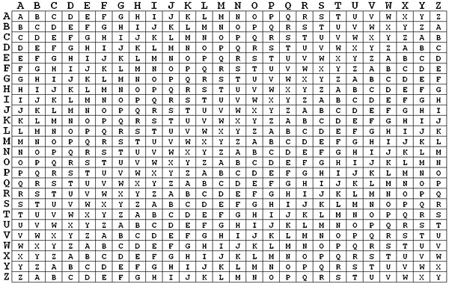

Slide 43
HILL CIPHER
Encrypt a group of letters called polygraphs
It can be digraph, trigraph, etc.
Use of Linear Algebra
Key and Plain text should be in the form of a square matrix.
To encrypt C= K P mod 26
To decrypt P = K⁻¹ C mod 26

Slide 44
MONO-ALPHABETIC CIPHERS
With only 25 keys, the Caesar cipher is far from secure.
An increase in the key space can be achieved by allowing an arbitrary substitution.
If the cipher can be any permutation of the 26 alphabetic characters then there are 26! Or greater than 4*10²⁶ possible keys.
This approach is reffered to as monoalphabetic substitution cipher, because a single cipher alphabet (mapping from plain alphabet to cipher alphabet) is used per message.

Slide 45
PERMUTATION
A permutation of a finite set of elements S is an ordered sequence of all the elements of S, with each element appearing exactly once.
For example is the S={a,b,c} then there are six permutation by the formaula n!
abc, acb, bac, bca, cab, cba

Slide 46
CRYPTANALYSIS
If the cryptanalysis knows the nature of the plain text then the analyst can exploit the regularities of the language.
The relative frequency of the letters can be determined and compared to a standard frequency distribution for English.

Slide 47
ONE-TIME PADS
Large, non-repeating set of keys is written on sheets of paper, glued together into a pad
Requires a prearranged chart called Vigenere table (contains 26 letters in each column in some scrambled order)
Receiver needs a pad similar to the sender

Slide 48
ONE-TIME PADS
Example:
  Message has 300 characters in length
  Keys are 20 characters long
  Sender needs 15 pages of keys
  Sender writes keys one at a time above the letters of plain text
  Sender encipher plain text with Vigenere chart
  Receiver uses appropriate number of keys to decipher message

Slide 49
ONE-TIME PADS
Problems
  Requires absolute synchronization between sender and receiver
  Difficult to store and account for the keys

